Slide 1
Data Science
An Introduction

Slide 2
What is Data?
Data is information that is taken to be axiomatically true
We can transform it, subset it, pre-process it and patch it up, but the numbers themselves are not to be questioned
You will spend a lot of your time cleaning and making data appropriate for use

Slide 3
What is Data Science??
Relatively new term
Encompasses traditional statistics, machine learning and business intelligence
“A better statistician than a computer scientist; a better computer scientist than a statistician.”
To be a good Data Scientist, you’ll need to have a good grasp of the theory behind the methods you use, know how and when to apply them, and be able to communicate your findings to non-technical individuals

Slide 4
Components - Statistics
Descriptive statistics – means, variance
Experimental statistics – ANOVA, T-tests, Chi-squared

Slide 5
Components – Machine Learning
Algorithmic methods – k-nearest neighbour, boosted graphs, decision trees
Bio-inspired methods – neural networks, genetic algorithms
These have a lot of overlap with statistics, and can be used in equivalent ways

Slide 6
Components – Business Intelligence
Data mining – finding meaning from the masses of data that an organisation produces
Related to Synthetic Data
Visualisation – presenting your data in the most appropriate ways
Histograms
Scatter plots
Nodal graphs

Slide 7
Questions we can ask
There are 5 questions that the plethora of Data Science techniques can answer:
Which category?
Is this anomalous?
How many?
What is the pattern?
What comes next?
Which question(s) you need to answer will inform which methods are needed.

Slide 8
How to answer them
Which category? -> Classification techniques
Is this anomalous? -> Anomaly detection techniques
How many? -> Regression techniques
What is the pattern? -> Clustering techniques
What comes next? -> Reinforcement learning techniques

Slide 9
Thinking Statistically

Slide 10
Statistics
Either the most tedious or most interesting topic you've even been introduced to. It is the Marmite of CompSci topics
Statistics at its worst is a bunch of memorised formulae
At its best, it is an insight into the workings of one's own mind, and the only way to tackle the masses of data produced by the world - both ancient and modern

Slide 11
Statistics
Statistics underpins risk, which underpins the modern financial system
It underpins planning, government, the modern world
Despite its lofty status, it is often amenable to innovations from all over - for example, one of the fathers of probability theory was only such due to wanting to win money from casinos.

Slide 12
Preparing your data
Checklist:-
Relevance
Completeness
Accuracy
Precision
Quantity
Scope
Data from the real world, is much like the real world itself:
Messy and confusing
Different algorithms can deal with messiness better and worse than others, but all benefit from having high-quality data
A good analogy here is teaching – it’s best to teach a student principles in an idealised way initially, than to pile all the complexity on them at once

Slide 13
Relevance
Your data must be relevant to the problem being solved
You can find much more irrelevant data in the world than relevant data
For example, the price of diesel and whether England wins the World Cup, are unlikely to be related to the chance of a hailstorm happening next week.
On the other hand, the CPU clock speed and VRAM of a computer are likely to affect its FPS in a given game.
Note that there are sometimes surprising correlations; you may need to use many techniques to rule them out.

Slide 14
Completeness
Your data is only as good as its completeness.
If you data is missing half its values, then you’re unlikely to get any meaningful predictions out of it.
Ice Cream (£) | Weather | Sales
0.75 | ? | 20
? | Rain | 12
1.50 | Rain | ?
0.75 | ? | 100
1.00 | Sunny | ?
Ice Cream (£) | Weather | Sales
0.75 | Rain | 20
1.00 | Rain | 12
1.50 | Rain | 3
0.75 | Sunny | 100
1.00 | Sunny | 85

Slide 15

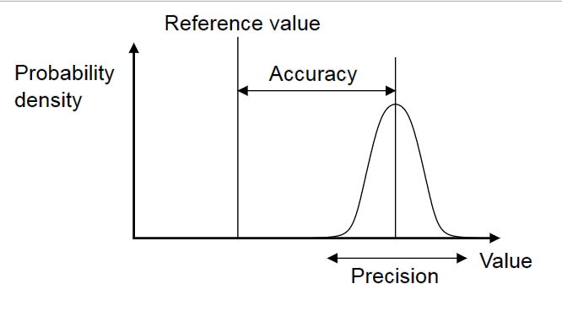
Accuracy and Precision
These are not the same thing.
The graph shows the definition of both relative to a single measurement:

Slide 16

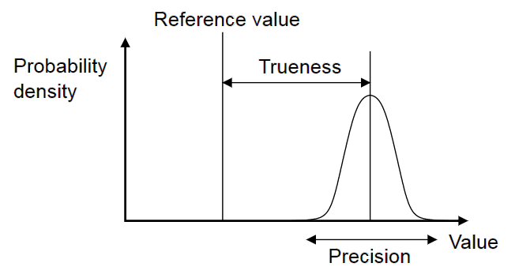
Accuracy and Trueness
When dealing with a group of data points – as in, all the time – the definitions change somewhat:

Slide 17
Quantity
Your data set must be sufficiently large to extract meaningful results from
If you want to study productivity trends across an entire business, is sampling 5% of the employees is sufficient?
No, especially if the scope is inappropriate
A larger data set is almost always better, especially considering storage of data has become so cheap
Large, freely available datasets are readily available – this is partly the reason for Data Science being such a hot topic right now

Slide 18
Scope
This is where Simpson’s Paradox lives
The context of your data is paramount to its usefulness – how it was gathered, the system it represents and what you might be missing
Inappropriately scoped data can be likened to having tunnel vision – things blindside you because you didn’t consider the wider context

Slide 19
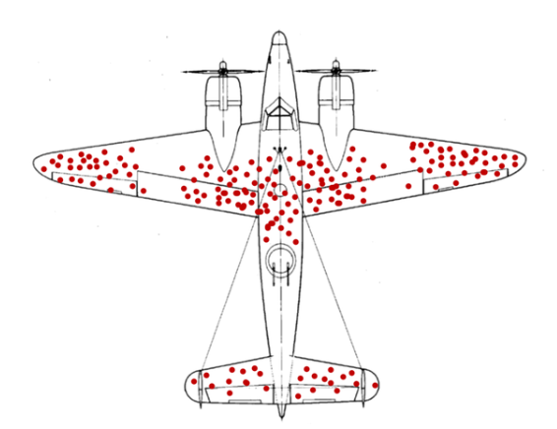
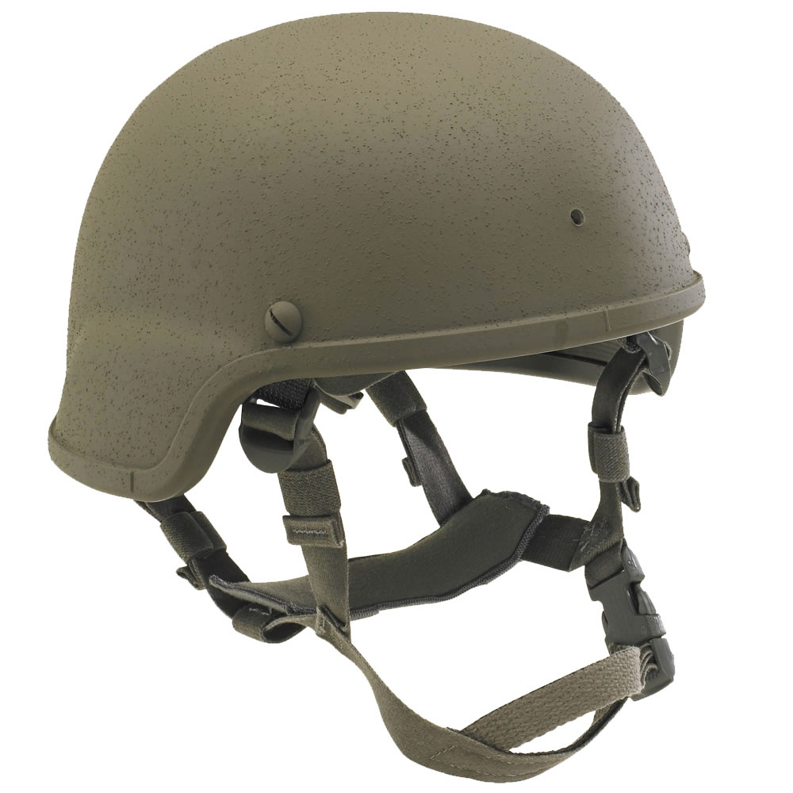
Counterintuitive Thinking
Much of Data Science can be counter-intuitive
Notes:
The following scenarios indicate some common logical pitfalls that both illustrate flaws in intuitive human logic and demonstrate the need for clear statistical thinking:
Scenario 1 (Plane):
It is WWII and the allies are beginning to turn the tide against the Nazis. However, air defences are inflicting huge causalities on the bomber squadrons, so it is decided to upgrade the armour plating. The drawback is that more plating is more expensive and adds more weight, affecting flight performance and range.
The diagram indicates where bullet impacts are most commonly found on returning aircraft. Based on this information, where should armour plating be added to best protect again enemy weapons?
Answer: Everywhere that bullet impacts aren’t recorded. The data is gathered from planes that have successfully returned to have their data recorded. This means that any recorded aircraft have sustained damage without being destroyed, and their impacts are therefore survivable. It follows therefore that the best places to add armour are those suspiciously free of impacts – the tail, the middles of the wings and the engines.
Scenario 2:
At the outbreak of WWI, soldiers were not allocated helmets, leading to many preventable deaths by head injury. After John Brodie patented the steel helmet in 1915, they were introduced in an attempt to prevent these injuries. However, soon after their introduction, head injuries rose four-fold and the medical bays were flooded with many more wounded troops. Army officials were on the verge of ordering a recall of the helmets. Questions: what happened, and was it a good idea to introduce the helmets?
Answer:
Once again, it is a case of sampling bias. Records of battlefield death were often missing the cause of death, due to the chaos of the battlefield and the obliteration of corpses by artillery. Many of those that would have previously died from head injuries would survive, but would require medical treatment, so the number of recorded head injuries increased. In fact, the huge surge in head injuries was an indication of the helmets’ success, not their failure.

Slide 20
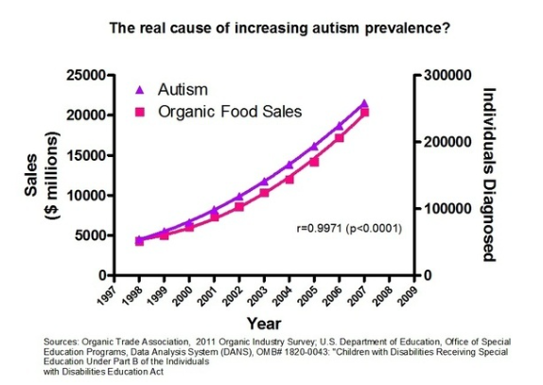
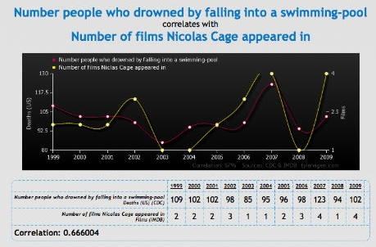
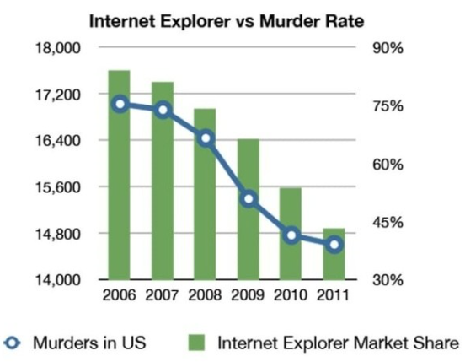
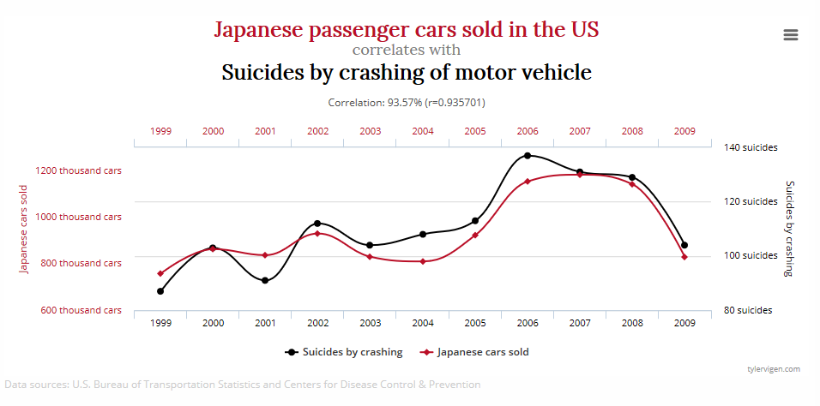
Spurious Correlations

Slide 21
Exploratory Analysis

Slide 22
Hypothesis Testing
When exploring a problem, it is useful to express the issue as a set of hypotheses. For a given research problem, there are two hypotheses in conflict with each other:
The current, status quo hypothesis that requires no additional evidence for us to be confident in
This is the Null Hypothesis
The proposed, uncertain hypothesis that we are investigating as an alternate (better) hypothesis
This is the Alternative/Research Hypothesis

Slide 23
Summary Statistics
Mean - 'average' value (they are all averages). The sum of values divided by the number of values.
Mode - most common value. Not exactly a good measure in highly precise measurements, alright for factors and integers
Median - the middle occurrence (by value, not be index). Unlike the other two, this is a real data point, and so can stop the ‘average salary of £15,000 a year' fallacy
Variance – the sum of the distances from the mean
Standard Deviation – the square root of the variance

Slide 24
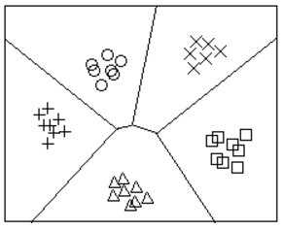
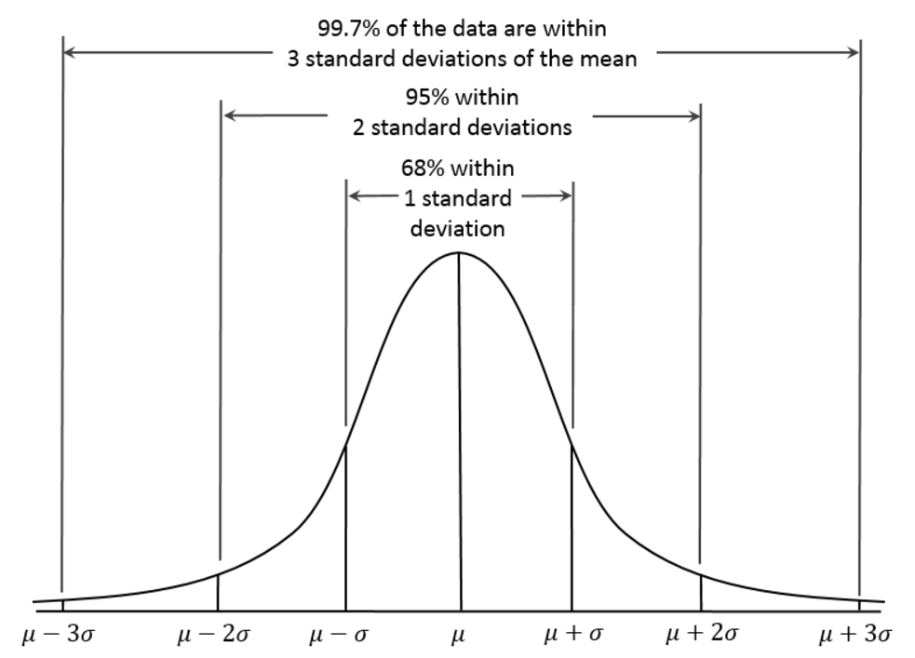
Boundaries and Distributions
Before we move into particular algorithms, it’s worth wrapping your head around a couple of concepts.
Decision boundary:
The areas for each category are known as Voronoi Cells
Probability distribution:
A Standard Deviation (σ) is the square root of the Variance of a data set
The Variance is the degree to which the data is spread out from its mean value

Slide 25
Normalisation
Another good technique to be aware of is Data Normalisation
Often, we have data with variables of many different ranges, but we don’t want these different ranges to weight the data unfairly
For example, the mass and height of a person will fall into wildly different ranges, with differing orders of magnitude
Normalisation is a common requirement for many algorithms, but its meaning and methods changes based on requirements
On the next slide, we use a variant called Feature Scaling, to make each feature fit into the same range.

Slide 26

Feature Scaling
$$x′=\frac{x−X_{min}}{X_{max}−X_{min}}$$
In this equation, x’ is your normalised data point, and x is your raw data point, X_{min} is the smallest data point in the variable and X_{max} is the largest.
Doing the maths, you can see that the minimum data point becomes 0, and the maximum data point becomes 1.
This makes sure that all the data fits between 0 and 1, whilst preserving their relative magnitude

Slide 27
Algorithms

Slide 28
k-nearest-neighbour
This is one of the simplest classification algorithms around
An example of non-parametric statistics
Very fast to run and to set up, but requires data to be normalised
It is also lazy – rather than generalising properly, building a representation of the data, it instead looks at a subset of its training examples, and compares new data to its memory.
The proper term for this is instance-based learning
It has two phases – training, and classification

Slide 29
KNN Training
Label | Value
A | 0.23
A | 0.32
B | 0.70
A | 0.11
B | 0.85
The algorithm receives a data set of many label-vector pairs
This is used as a template from which it can predict novel data
Since it is directly reliant on its training data to work properly, make sure this data is complete and with proper scope

Slide 30
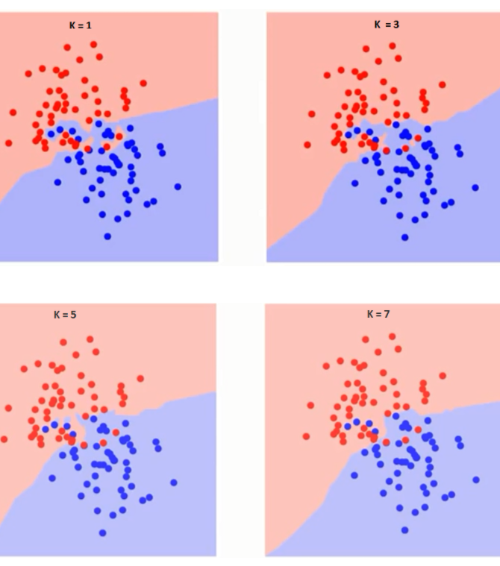
KNN Classification
With a template stored, the KNN algorithm can now classify novel-yet-similar data points:
A key value is the radius (k) that it searches within. This is determined by the user, and will effect different results depending on how it is set
Notice how each class group has an ‘area of influence’ that defines the cluster

Slide 31
KNN In Action
The KNN builds up a Voronoi tessellation showing the areas a category occupies in the data space:
New data points can then be compared against this ‘template’ to have their category determined
Note how the k-Value determines a point’s categorisation
Key:
k = 1
k = 5
k = 11

Slide 32
k-Value
We need a good way to decide on the appropriate k-Value
The error rate is a good place to start
If the error rate is 0, something is very wrong
As we increase the k-Value, we will see it fluctuate until we reach an optimum point.
If we didn’t have any test data, this would be impossible – so remember to split your training data for testing purposes.

Slide 33
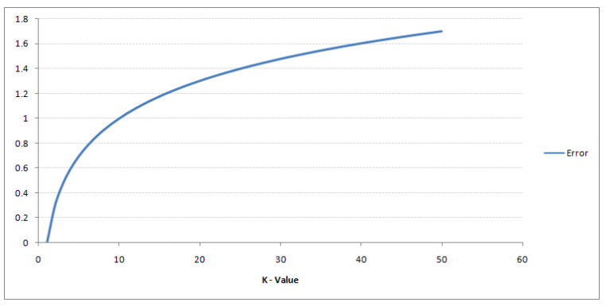
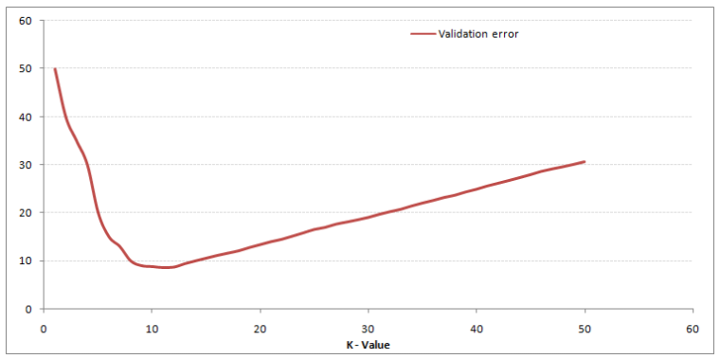
k-Value Validation
Compare the training error compared to the validation error:
0 error is always too good to be true – the real world is not like that
However, with proper validation, the optimum k-Value should be easy to work out

Slide 34
KNN Pros and Cons
KNN overfits completely to its training data
This is useful in some ways, as this level of generalisation is acceptable for some applications, especially in light of its speed
However, this also means it can be inflexible
KNN has a complex decision boundary
This helps it to fully capture all the features of the training data
When might this be an issue?

Slide 35
KNN Worked Example
Let’s dive right in with a high-dimensional data set
For this, we will use the UCI’s Breast Cancer data set
It has 31 Variables that can be used to determine the categorisation of a cell – cancerous, or not cancerous
From this, we will build a decision boundary, validate the model, and see how it performs on novel, unlabelled data

Slide 36
Example R Code
To do a KNN in R, we will import the class package
This contains a range of classifiers, including KNN
Once the dataset is imported, you will need to determine which variables are worth including and do any transformations necessary to make the data fit for the KNN algorithm

